Slide 1



How far you have come
Susanne Salem-Schatz, Sc.D.
sss@HCQI.com

Slide 2


Slide 3
UTI in the Elderly Collaborative
10/13
Kickoff Workshop
12/13
Clinical
Webinar
1/14
Evaluating Altered mental status webinar
6/14
Closing Workshop
2/14
Regional workshops
4/12
Antibiotic Stewardship
Webinar
4/14
Coaching and sharing call
TEST / IMPLEMENT / SUSTAIN
MEASURE / MONITOR

Slide 4
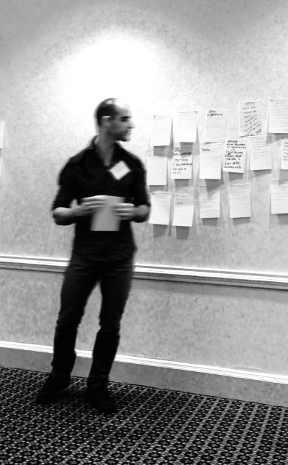
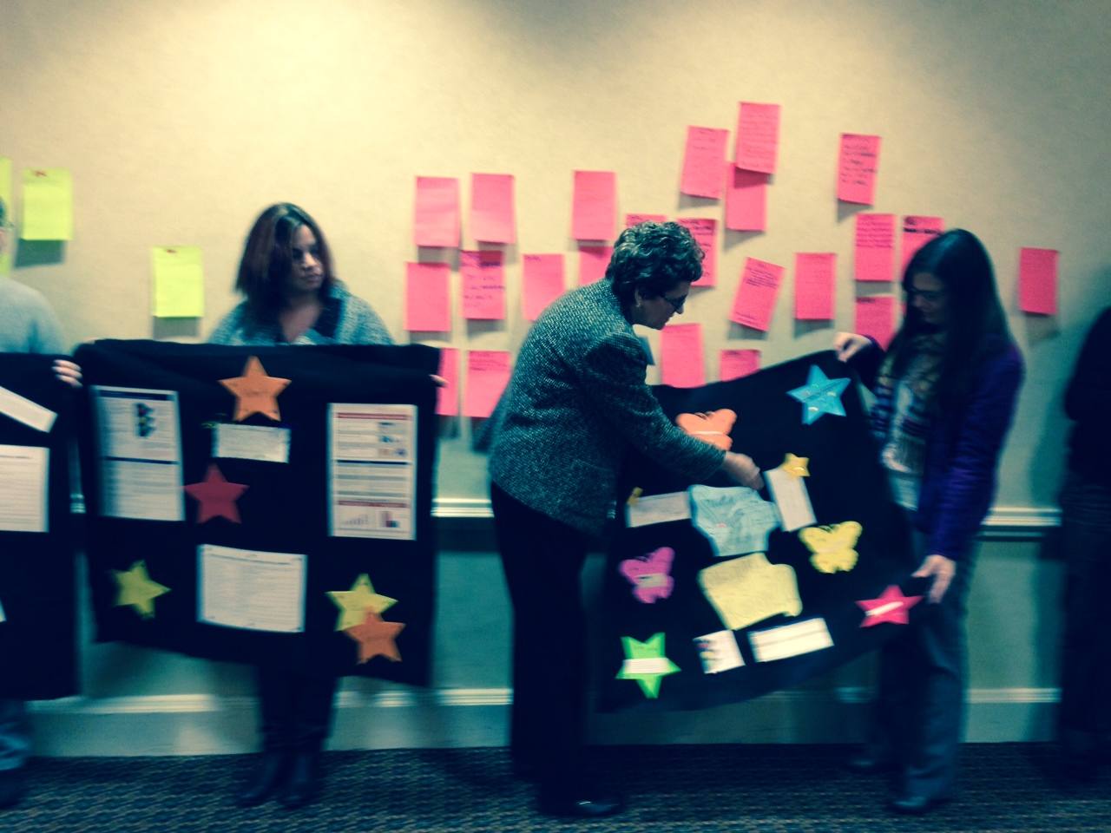
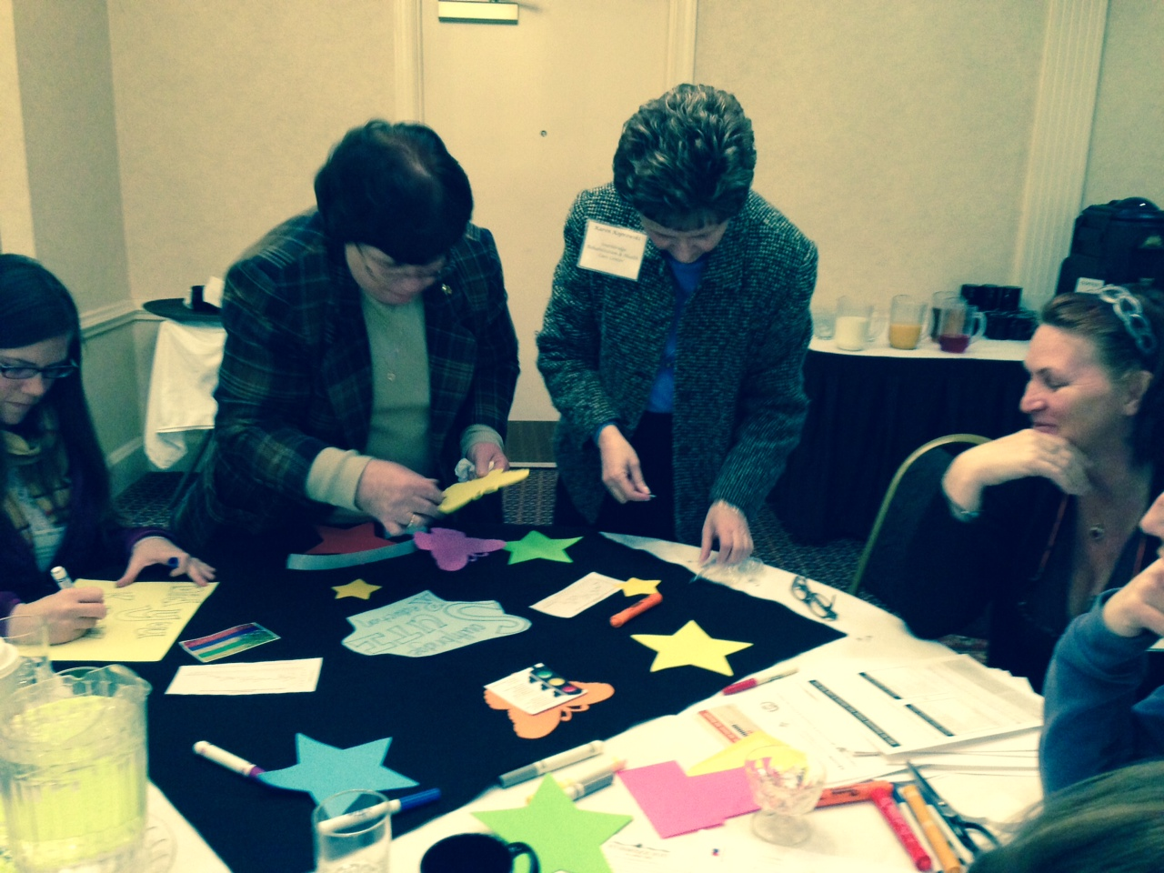

Slide 5
UTI in the Elderly Collaborative
10/13
Kickoff Workshop
12/13
Clinical
Webinar
1/14
Evaluating Altered mental status webinar
6/14
Closing Workshop
2/14
Regional workshops
4/12
Antibiotic Stewardship
Webinar
4/14
Coaching and sharing call
TEST / IMPLEMENT / SUSTAIN
MEASURE / MONITOR

Slide 6
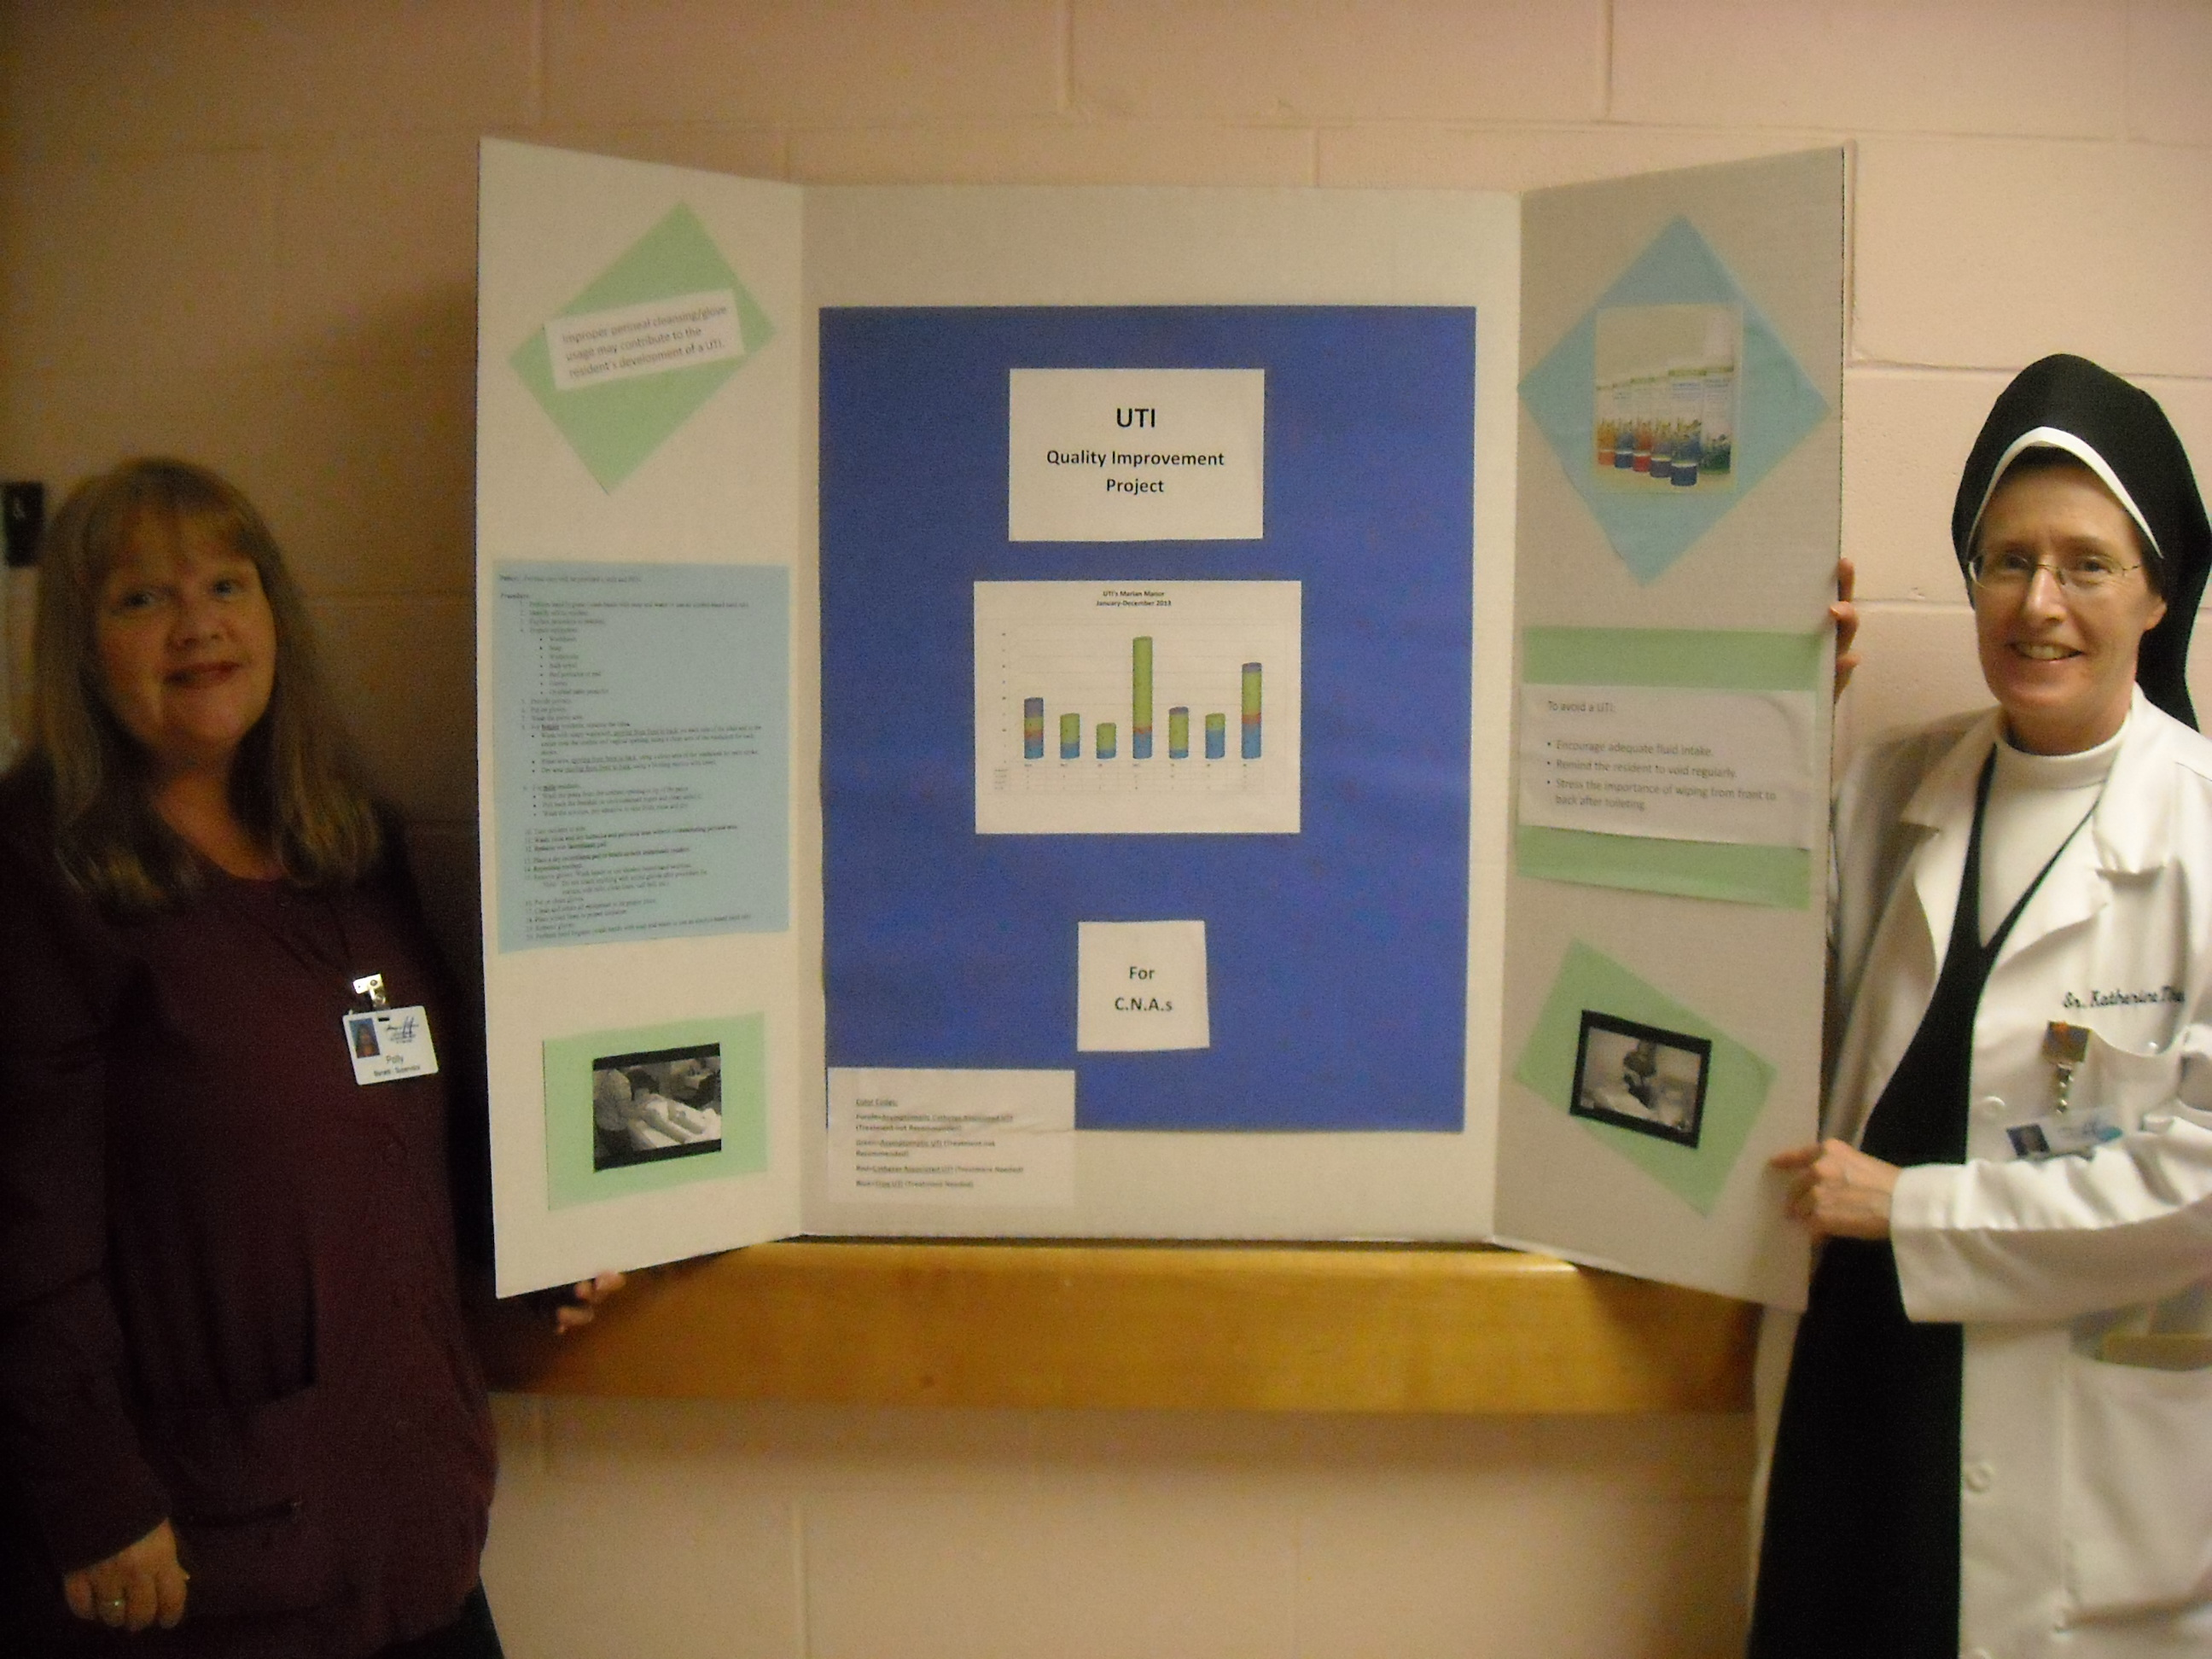
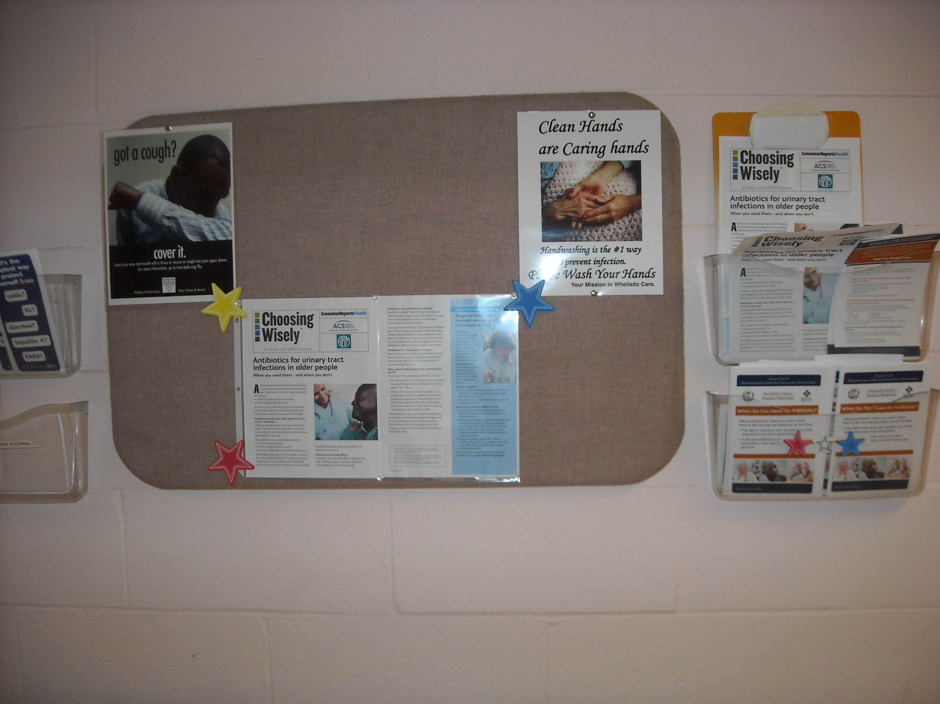
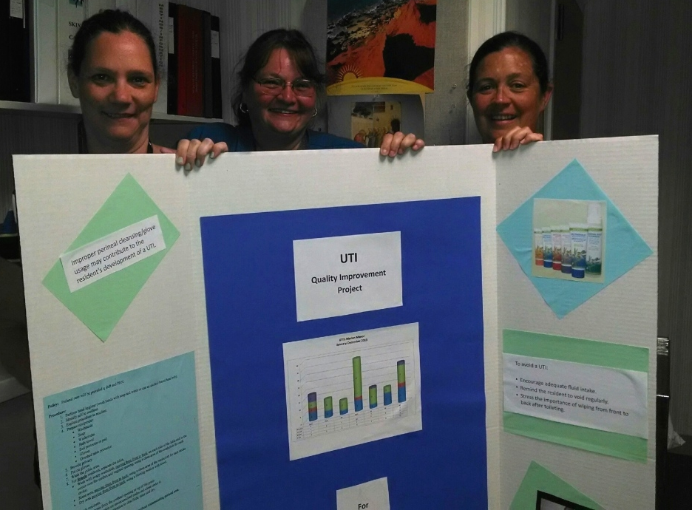
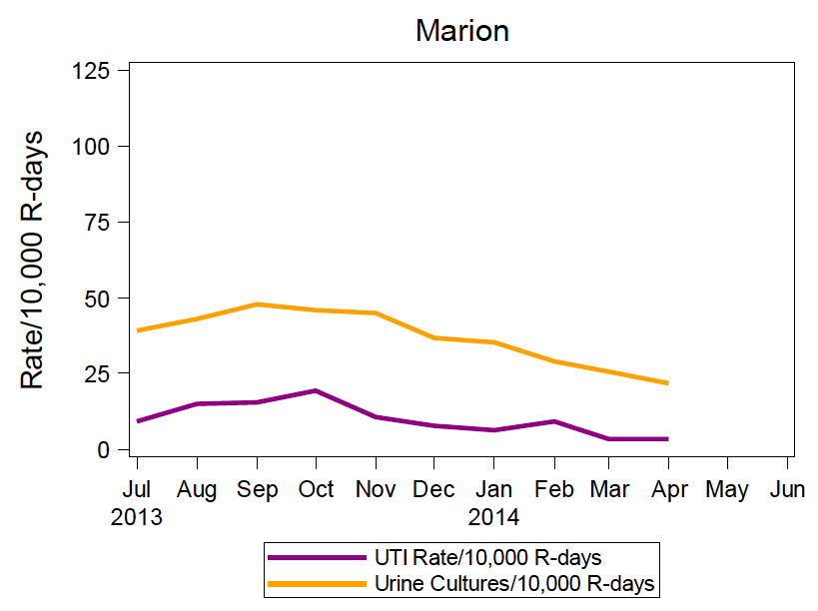
MARION MANOR

Slide 7
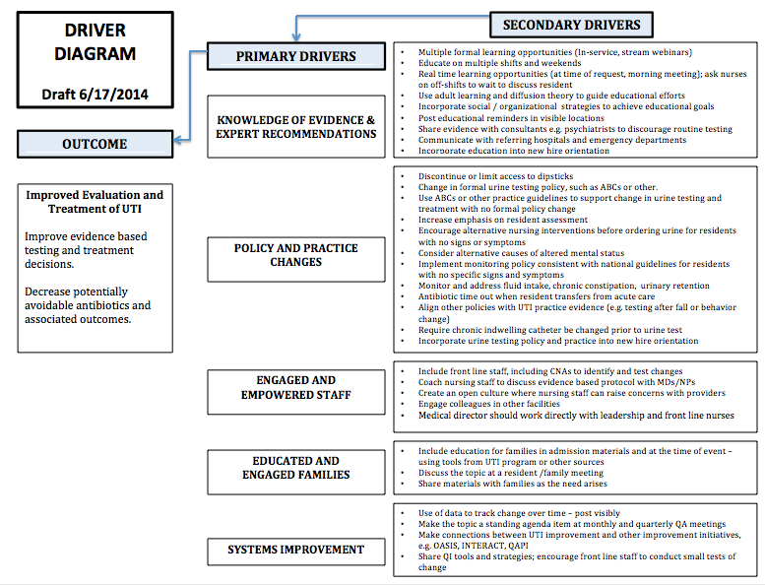

Slide 8
UTI in the Elderly Collaborative
10/13
Kickoff Workshop
12/13
Clinical
Webinar
1/14
Evaluating Altered mental status webinar
6/14
Closing Workshop
2/14
Regional workshops
4/12
Antibiotic Stewardship
Webinar
4/14
Coaching and sharing call
TEST / IMPLEMENT / SUSTAIN
MEASURE / MONITOR

Slide 9
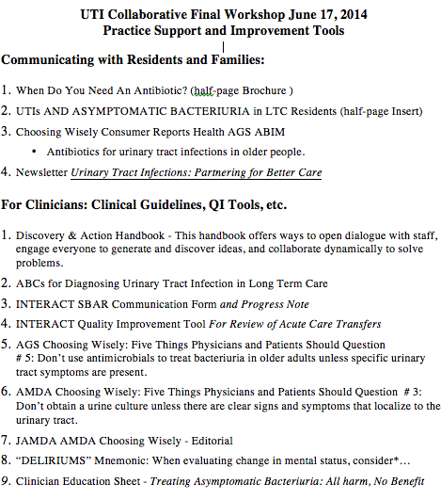

Slide 10
UTI in the Elderly Collaborative
10/13
Kickoff Workshop
12/13
Clinical
Webinar
1/14
Evaluating Altered mental status webinar
6/14
Closing Workshop
2/14
Regional workshops
4/12
Antibiotic Stewardship
Webinar
4/14
Coaching and sharing call
TEST / IMPLEMENT / SUSTAIN
MEASURE / MONITOR

Slide 11
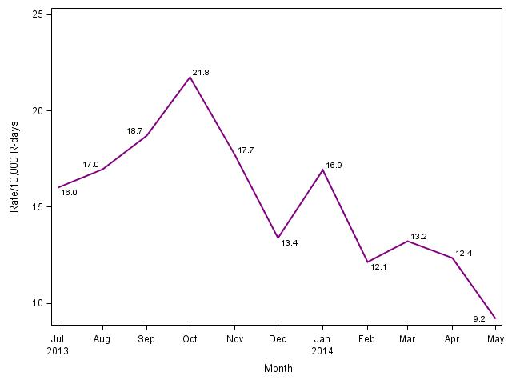
Urinary Tract Infection Rates in New Facilities (n=13)
Second Collaborative

Slide 12
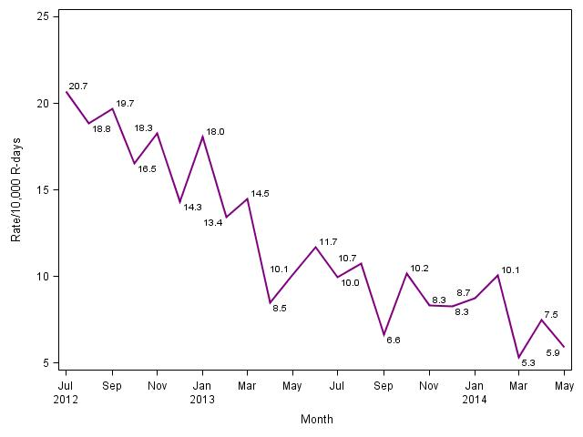
Urinary Tract Infection Rates in Continuing Facilities (n=10)
First Collaborative
Second
Collaborative

Slide 13
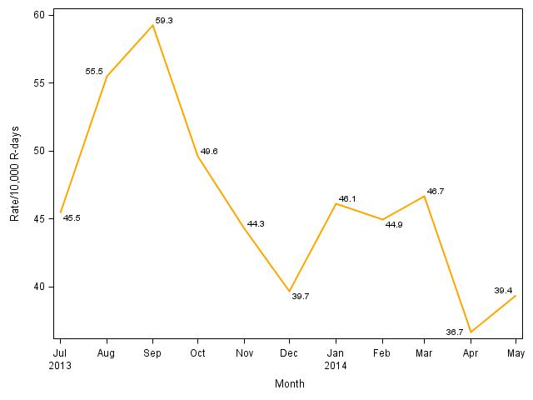
Urine Testing Rates in New Facilities (n=13)
Second Collaborative

Slide 14
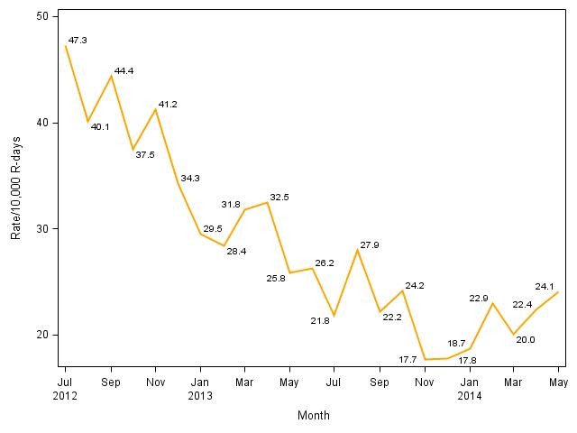
Figure 2. Urine Testing Rates in Continuing Facilities
First Collaborative
Second
Collaborative

Slide 15
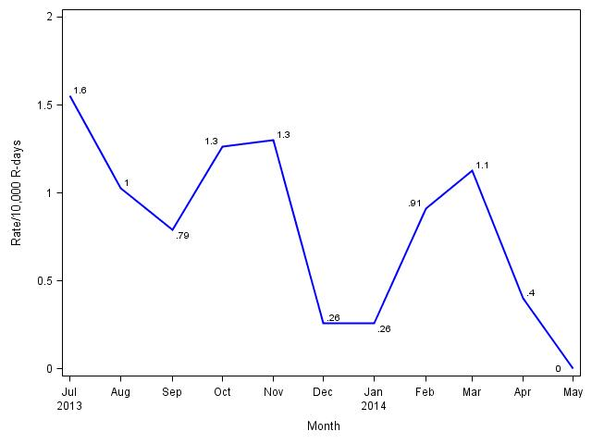
C. difficile Rates in New Facilities (n=13)
Second Collaborative

Slide 16
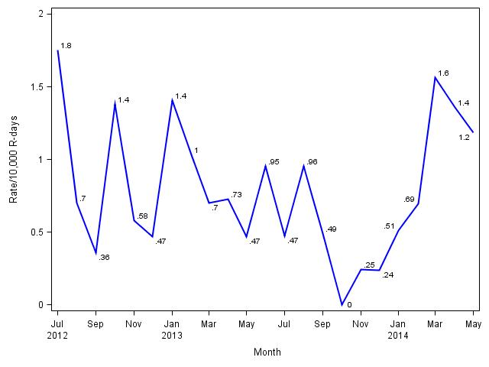
C. difficile Rates in Continuing Facilities (n=10)
First Collaborative
Second
Collaborative

Slide 17
Learning from our Experience
Presentations
Conversation
Listen for the what and the how
  What sounds familiar?
  Good ideas to try?
  Building on the efforts of others?
Share ceaselessly, steal shamelessly

Slide 18



Slide 19
Important lessons for life and quality improvement
You can’t change your boyfriend or husband.
It’s your job to get along with your mother-in-law
Three strikes and a man is out, no matter how good his pitches.
Dear Abby,
Despite our best efforts, one of our weekend physicians insists on ordering a urine test if a resident has a fall. We have told him about the protocol over and over, but he just won’t change! What else could we do?
signed,
Weary in Waltham

